Slide 1




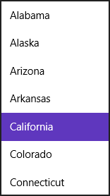
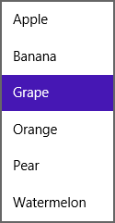

Button (<button> <input type="button">)
Hyperlink (<a href>, <link>)
Checkbox (<input type="checkbox">)
File Upload (<input type=“file">)
Drop-Down (<select>)
Slider (<input type="range">)
ListBox (<select>)
Progress Bar (<progress>)
(determinate)
(indeterminate)
Progress Ring (<progress>)
Radio Button (<input type=“radiobutton">)

Slide 2
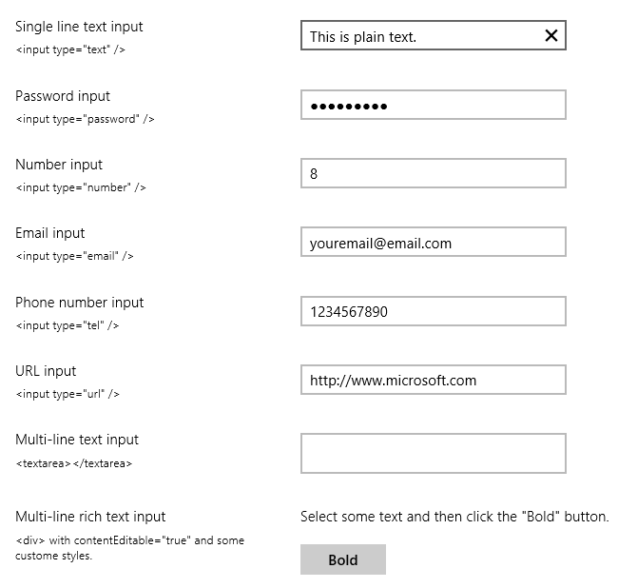
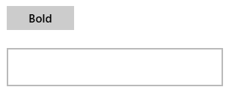
Clear Button shows when entering text; oninput event fires when pressed.
Single-line text (<input>; all HTML5 types are supported)
Reveal button (shows password characters)
Multi-line text (<textarea>)
Rich text (<div>)

Slide 3





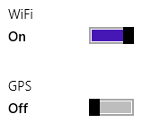
BackButton
DatePicker
Rating
TimePicker
Tooltip
ToggleSwitch

Slide 4
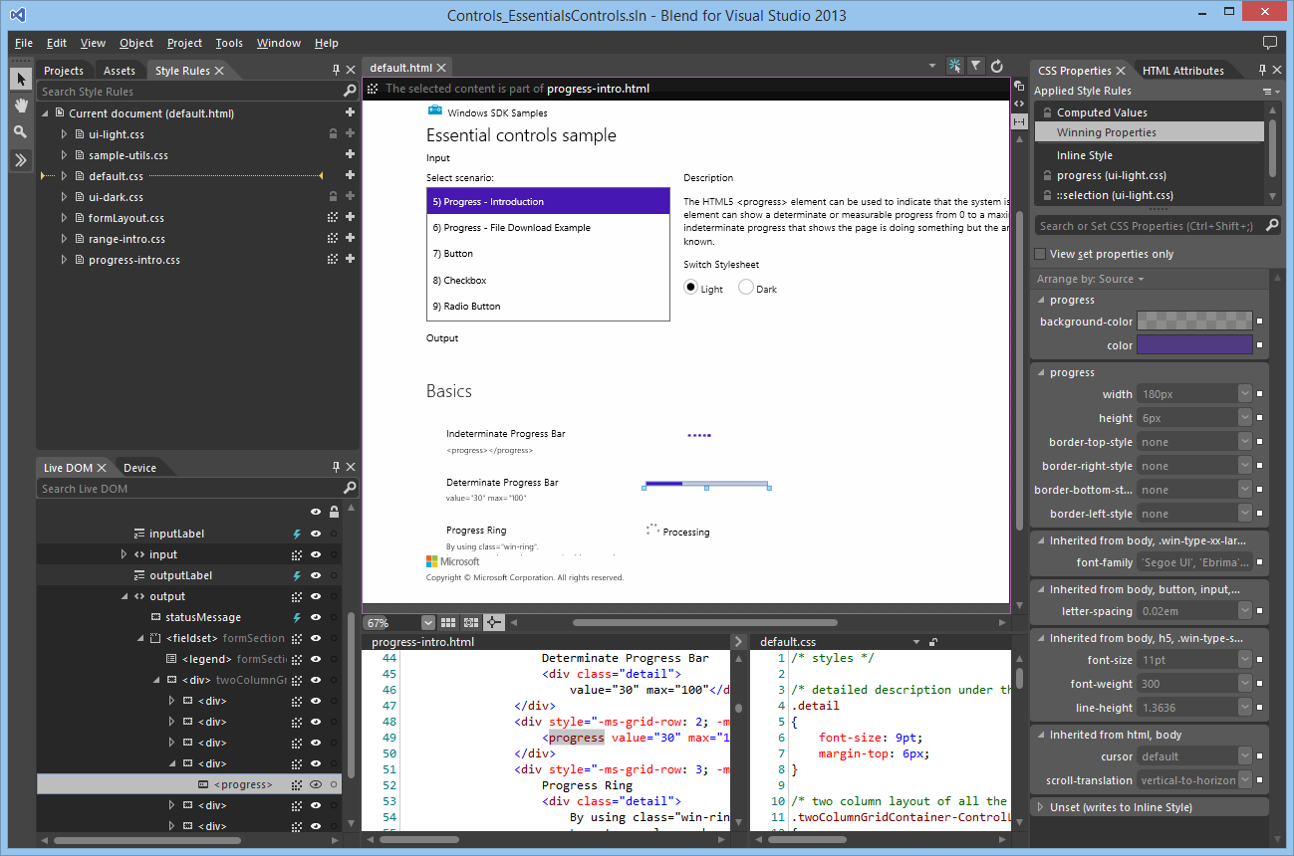
Clicking on an element in either the Live DOM or the artboard highlights it in the other. This makes for easy selection and styling.

